Slide 1
INTRODUCTION TO PYTHON

Slide 2
OVERVIEW
What is Python?
Basic Python Syntax
Creating Simple Python Programs (Number Guessing Game, Positive Number Detector)

Slide 3
1
What is Python?
Python is an interpreted, high-level computer programming language
Simple Syntax
Extensive standard library and community packages
Rapid development times

Slide 4
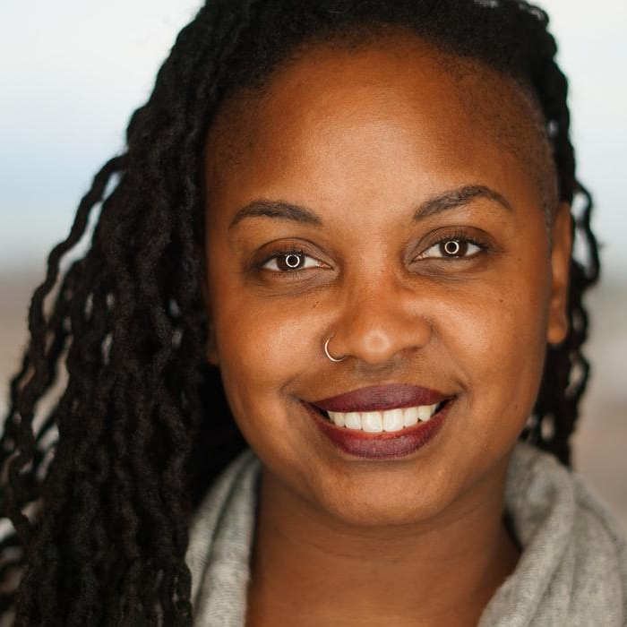
Hello world!
With Python
Reading from standard input (stdin)
Writing to standard output (stdout)

Slide 5
Python Syntax
Strings
Booleans
Integers and Floats
Lists and Dictionaries

Slide 6
2 Creating Simple Python Programs
Number Guessing Game
Positive Number Detector

Slide 7
Number Guessing Game
Store a number
Ask user to make a guess
Check if the guess is the same as our number
If so/true, player wins, game over!
Else, give the user some hints.

Slide 8
Positive Number Detector
Ask user to enter a number, `user_no`
Make sure `user_no` is actually a number (Validation)
If the number is positive (user_no >= 0), print `True`
Else, print `False`

Slide 9
Thanks!
ANY QUESTIONS?

